Slide 1



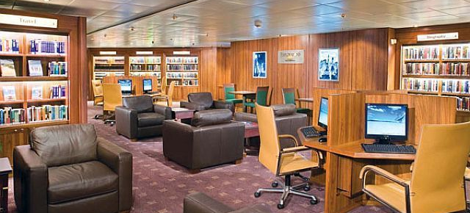
Is it busy
Created by
Michalis Iona
Nicholas Navarro
Georgi Georgiev

Slide 2
What is it ?
Software designed for lower-end devices
Collects MAC addresses connected to a WIFI-network
Analyses collected data
Publishes results with MQTT, allowing remote interactions

Slide 3

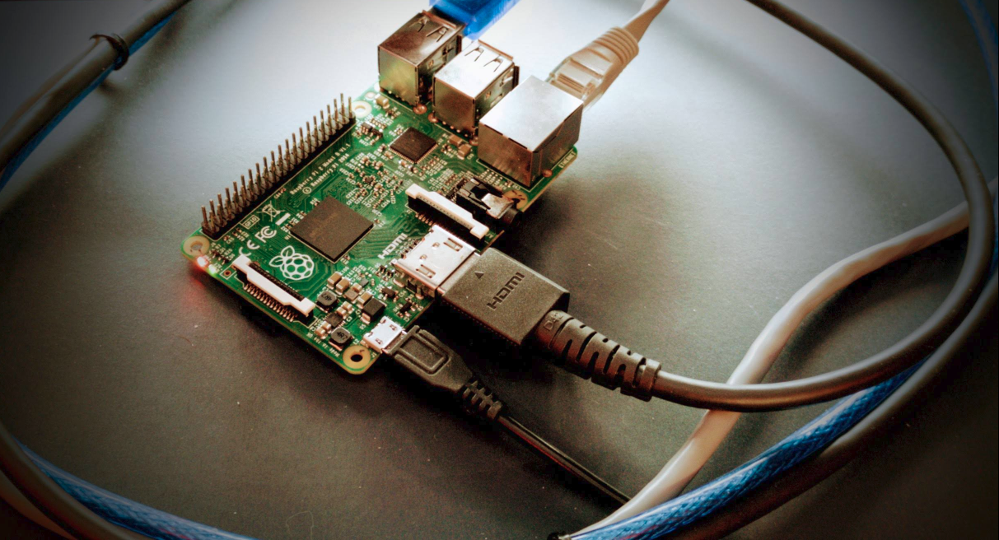
how does it work?
Why MAC addresses?
Why low-end devices?

Slide 4
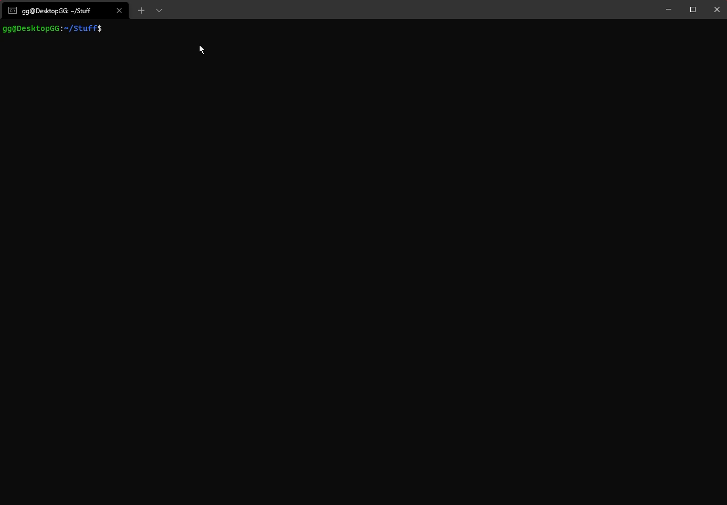
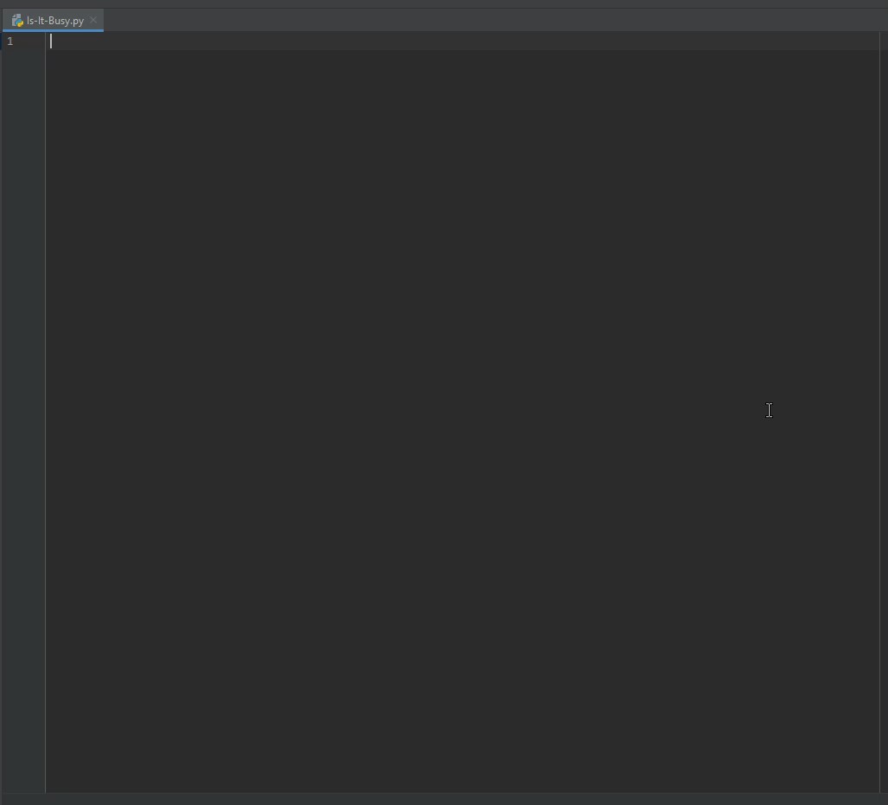
How was it made?
Kali Linux OS
Python
Arp-scan
Paho-mqtt

Slide 5
Possible applications and considerations
Tracking traffic in public locations
When image recognition is added, it can serve as a security tool
Analysing consumer behaviour
Tracking stolen devices
Ethical and legal issues

Slide 6
Thank you for your time!

